Slide 1


OPEN SOURCE PLASTIC
RECYCLING MACHINE
Mardi 26 Octobre
Notes:
WILLIAM

Slide 2




Table of contents
1 - Recap of the previous audit
2 - Updated Gantt
3 - The installation of the hopper
4 - Wiring diagram
5 - First version of safety rules and regulations
Notes:
WILLIAM

Slide 3

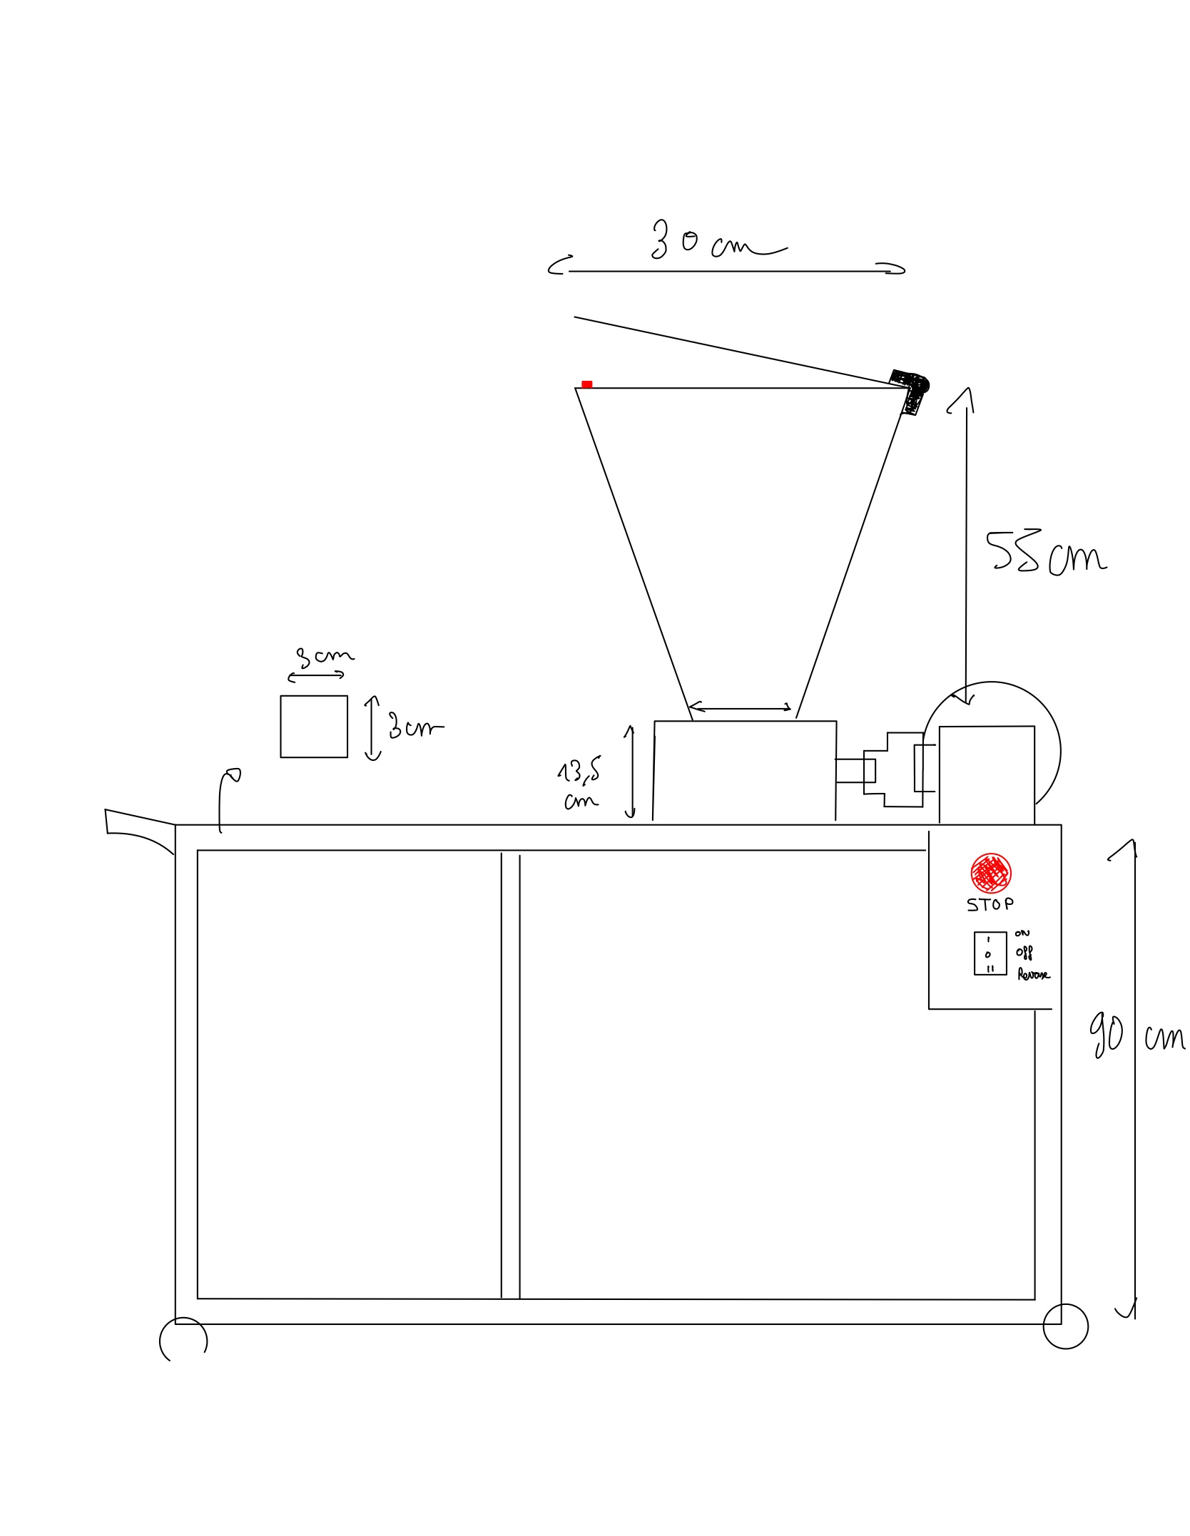
Recap of the previous audit
Germain LEMASSON, FabManager FabMSTIC ; He wants ABS & PLA big ships plastic thanks to our low cost shredder
Presentation of the client and his expectations
Presentation of the physiotherapist and his expectations
Manuel FRANÇOIS, Physiotherapist, Orthotist ; He wants new plastic plate thanks to our ‘hoven’ and the unusable piece of plastic given by him
Organisation
Gantt & risk analysis
Systems engineering of the shredder
Stakeholders diagram
CAD and first progress
CAD of the hopper
Installation of the converter
Notes:
MAXIME

Slide 4
Table of contents
1 - Recap of the previous audit
2 - Updated Gantt
Notes:
WILLIAM

Slide 5
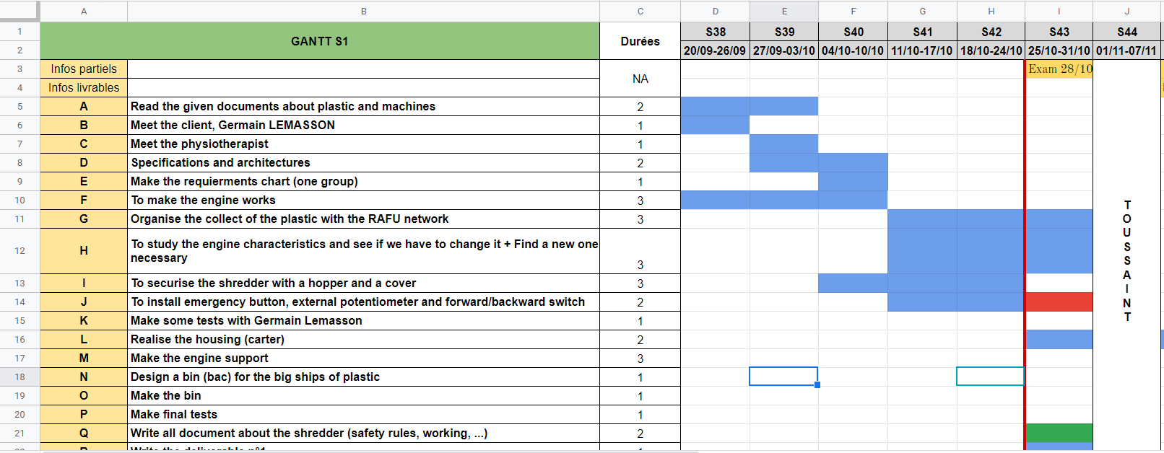
Updated Gantt
Notes:
Someone else

Slide 6
Table of contents
1 - Recap of the previous audit
2 - Updated Gantt
3 - The installation of the hopper
Notes:
WILLIAM

Slide 7
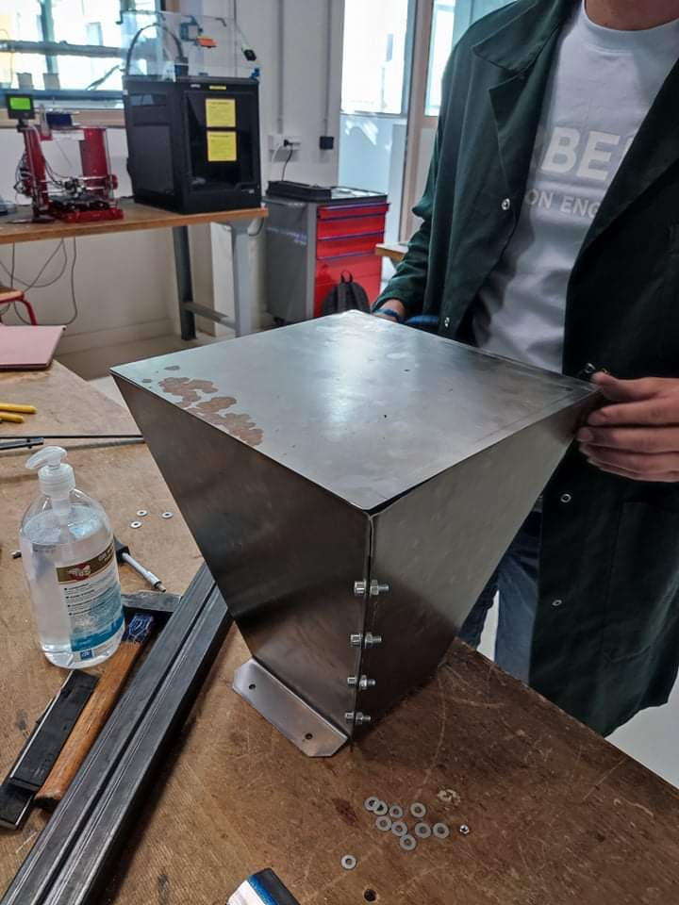
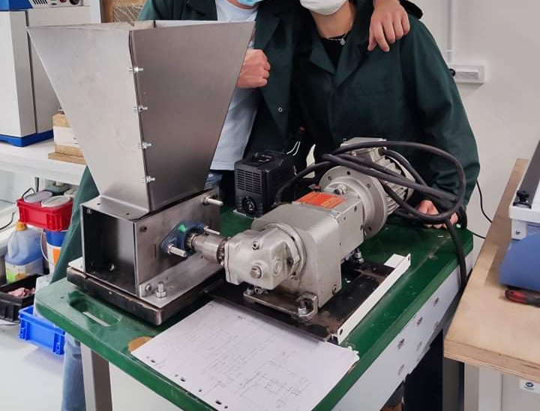
The installation of the hopper
The final result
1. Bending of the 2 sheets
2. Assembly of the 2 parts
3. Attaching the hopper to the shredder
Notes:
MAXIME

Slide 8
Table of contents
1 - Recap of the previous audit
2 - Updated Gantt
3 - The installation of the hopper
4 - Wiring diagram
Notes:
WILLIAM

Slide 9
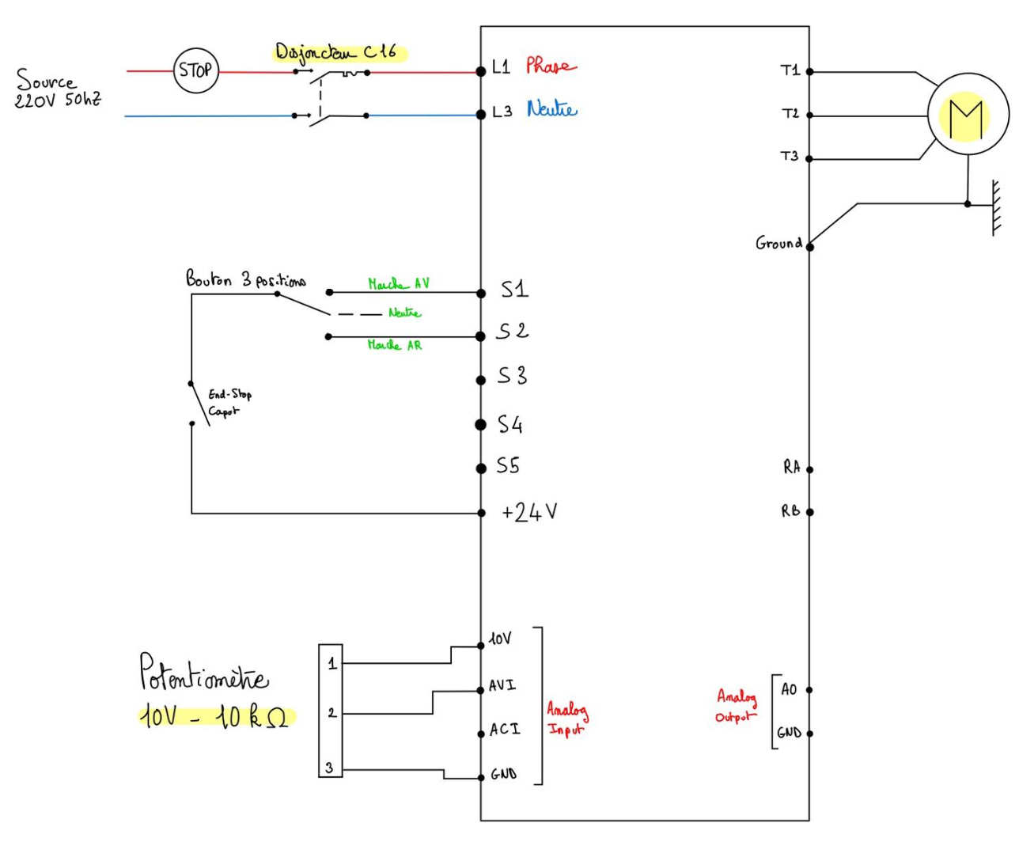
Wiring diagram
Buttons that will be present :
Emergency stop with a circuit breaker (disjoncteur)
Button on/off
Button 3 positions
Other elements :
End stop for the hopper
A potentiometer
And the engine of course
Notes:
Rajouter voyants pour allumer/éteint
Rajouter yellow flashing LED

Slide 10
Table of contents
1 - Recap of the previous audit
2 - Updated Gantt
3 - The installation of the hopper
4 - Wiring diagram
5 - First version of safety rules and regulations
Notes:
WILLIAM

Slide 11



First version of safety rules and regulations
Avoid putting too much plastic into the shredder as this can wear down the motor.
When the machine is in motion, putting your hand into the crusher is forbidden to avoid injury.
Avoid putting hard objects to avoid damaging the blades.
Regularly lubricate and maintain the running parts.
Always clean the shredder after using it to shred a particular type of plastic.
Keep Jewelries, long hair, or loose clothing (i.e neckties) away from the plastic shredder opening.
Always turn off and unplug the power source when the machine is not in use.
Notes:
Someone else

Slide 12
Interrogations
Notes:
Someone else

